Slide 1
SOEN 341 week 1
Introduction to the Software Process

Slide 2
Origins of Software Engneering
The term “Software Engineering was first used by:
  Oettinger, Anthony (1967). "The hardware-software complementarity". Communications of the ACM
The world’s first conference on Software Engineering was held in 1968
The discipline of software engineering was created to get projects exceeding time and budget under control.
It proposes that software can be built systematically, rigorously, measurably, on time, on budget, and within specification, according to engineering principles

Slide 3
Engineering Projects
An engineering project, such as an infrastructure project, Proceeds along clearly defined phases
Requirements are defined by the client and are refined and agreed upon by the contractor.
Architects and engineers draw up plans according to best engineering practices.
The plans are then implemented by builders, under the supervision and inspection of the engineers

Slide 4
The Engineered Software Development Process
Development of software on a commercial basis, particularly under contract, requires
a structure and organization that will :
  use the resources of the developer efficiently
  ensure that the product meets the requirements of the client in terms of:
    Function, Performance, and Reliability.
    (These three terms include much detail, ranging from usability to maintainability)

Slide 5
Software Process Phases
There are many different software processes, but they all share the same basic elements.
The difference is in how these elements are organized.
The classic process is sequential, and was called the waterfall process, because the implication was that each phase would feed into the next without further interaction.
It is modelled on the engineering process that is used to construct infrastructure
See the next slide.

Slide 6
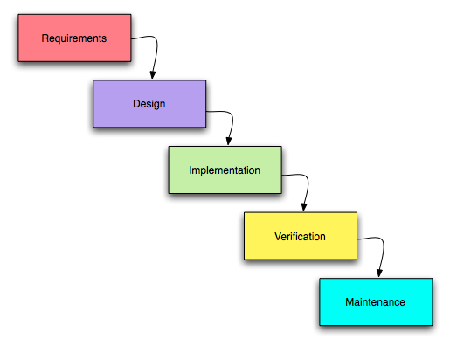
Waterfall Model

Slide 7
Waterfall and reality
In fact, lack of interaction is not practical, and never was.
  Much has been written criticizing the waterfall model, but in fact the original authors never excluded interaction.
  It is a useful model, because it clearly defines a sequence of events that is contractually verifiable and legally defensible, analogous to a large civil engineering project.

Slide 8
Waterfall in Software and Classic engineering
The problem is that software projects are never as well understood as classic engineering projects
For the purpose of this course, The deliverables of the project follow a waterfall like sequence, but within this frame, there is much scope for agile and iterative development.
We shall discuss all of this, but first the phases.

Slide 9
Discovery, planning, and risk
Discovery: This involves understanding thoroughly the problem, and reaching a clear agreement with the client on the deliverables. This starts with the domain model.
The layout of the process requires careful planning, and the plan of attack will depend on how confident the development team is on the product design, and the tools to be used in the project.

Slide 10
Elements of the process
Domain Analysis
  "Domain Analysis“ is the investigation of the so-called "domain" of the software, i.e. the nature of the project and its environment.
  This involves an understanding of what is being said by the client experts in in terms of the domain's own terminology
  This phase is an important prelude to extracting and gathering the requirements, and creating a correct specification.
  This is the first phase of your project

